Slide 1
Agile Fundamentals
A Course from
ThoughtWorks Studios
CONFIDENTIAL AND RESTRICTED.
These materials are for the sole use of the individuals to whom they were delivered, and any further copying or distribution is prohibited.
Notes:
Hello, and welcome to The Origins of Agile Software Development, a module in Agile Fundamentals. This module is brought to you by ThoughtWorks Studios, makers of Mingle, Go, and Twist.

Slide 2
How much agile knowledge?
No knowledge
Expert
Notes:
Arrange yourselves around the room
Experts on one side, those with no agile knowledge on the other
Arrange yourselves in approximate order of your knowledge of agile
We call this self-organizing

Slide 3
To start…
Find a partner, so you have some balance of expertise – we call this pairing
Take an index card – write “What We Know” on top
Together, write-down up to 5 agile techniques and what they are used for
You have 5 minutes for this
One of you keep the card – we will use it later
Notes:
Have the most experienced and less experience pair, second most/second less, etc. until all paired
They can sit down, or continue standing for this exercise

Slide 4
And a second thing…
Still in your pair, take a Post-It note
Write one question you both agree on you want to answered by this workshop
Stick the Post-It on the wall over here
We will visit these questions throughout the workshop
Notes:
Have them sit at the end of this (if they are not already sitting)

Slide 5
Introductions
Who are you?
What do you do?
Why are you here?
All in 30 seconds or less.
Notes:
TIMING:
Introductions: < 5 minutes
Group Juggle: 5 – 8 minutes
Follow introductions with Group Juggle…
http://wilderdom.com/games/descriptions/GroupJuggle.html
Group Juggle
Fun way to start working together.
Can be used to learn names and develop a sense of interconnectedness.
Stand in a circle, toss a ball to someone, using his/her name, and they in turn toss it to someone else, using the next person's name.
Keep it going, then more balls are introduced and it starts gets crazy.
How to Run a Group Juggle Session
Set up & instructions for 1st round of group juggling
Arrange participants in a circle, not too close, not too far from one another
Include yourself in the circle
Explain that you are going to throw a ball to someone - pick someone out & ask their name, then say
"Hi Freddy, my name is James...here you go!" [underarm throw a ball to Freddy]
Freddy then says "Thank you James", picks someone and says "Hi X, my name is Freddy...here you go!" [throw]....they say "Thank you, Freddy] and on we go.
If you're not trying to learn names, skip the naming part & just throw!
The challenge from here is simply to get the ball thrown around to everyone in the circle, and finally back to the trainer.
2nd round of group juggling
I then say, "Right, well done, now let's see if we can that again - making sure we use the same order, and using each other's names. Remember to say the name of the person you are throwing to, and thank the person, by name, for throwing it to you, OK?"
On the second round, most people will be challenged to remember who to throw it to, and the two names! Take it slow, help the group out, so that each person has a successful second round.
3rd round of group juggling
I then say, "Good, so how about we do it again, but this time, let's let's see how fast we can do it, OK? Here we go...Hi Freddy, my name is James...." [throw]
It will go pretty fast this time, and the group will probably feel quite pleased with themselves.
4th round of group juggling - introducing more balls
I then say, "That's great, but I think you can do faster than that. Come on, let's see how we can really go..." [I then throw and say the name with super fast enthusiasm to set the tone!]
After the first ball has passed through a few hands, I take a 2nd ball out of my pocket (surprise!), and casually, but earnestly say "Hi Freddy...." [throw].
By now everyone is so well trained, the 2nd ball will automatically keep going, and there will be a detectable sense of challenge/excitement.
After a bit, I introduce a 3rd and 4th ball, up to about 6 balls.
Usually I let 4 to 6 balls be juggled for a while (note the balls will be coming back again to the trainer - just keep them going). A group of 12 adults can usually handle 4 to 6 quite well.
If I'm feeling conservative, I just let the group have the success of doing this number of balls, and collect them in when that seems to have been achieved.
But usually, once the group seems competent at 4 to 6 balls I gradually then introduce an unmanageable number of balls into the juggle & maybe also weird objects (e.g., kids soft toys) which all gets crazy, fun, out of control, etc. and ends in a hilarious shambles.
Generally doesn't require debriefing.

Slide 6
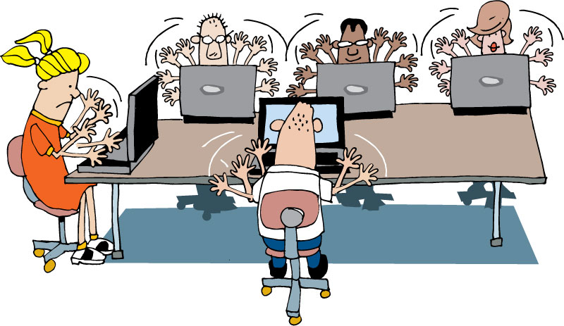
Housekeeping
Mobile phones
Laptops
Break times
Restrooms
Emergencies

Slide 7
What’s coming up…
Run an agile project
Build, test, and release a product
All using agile principles
Notes:
Introduce the concept of the Lego game, but not in great detail

Slide 8
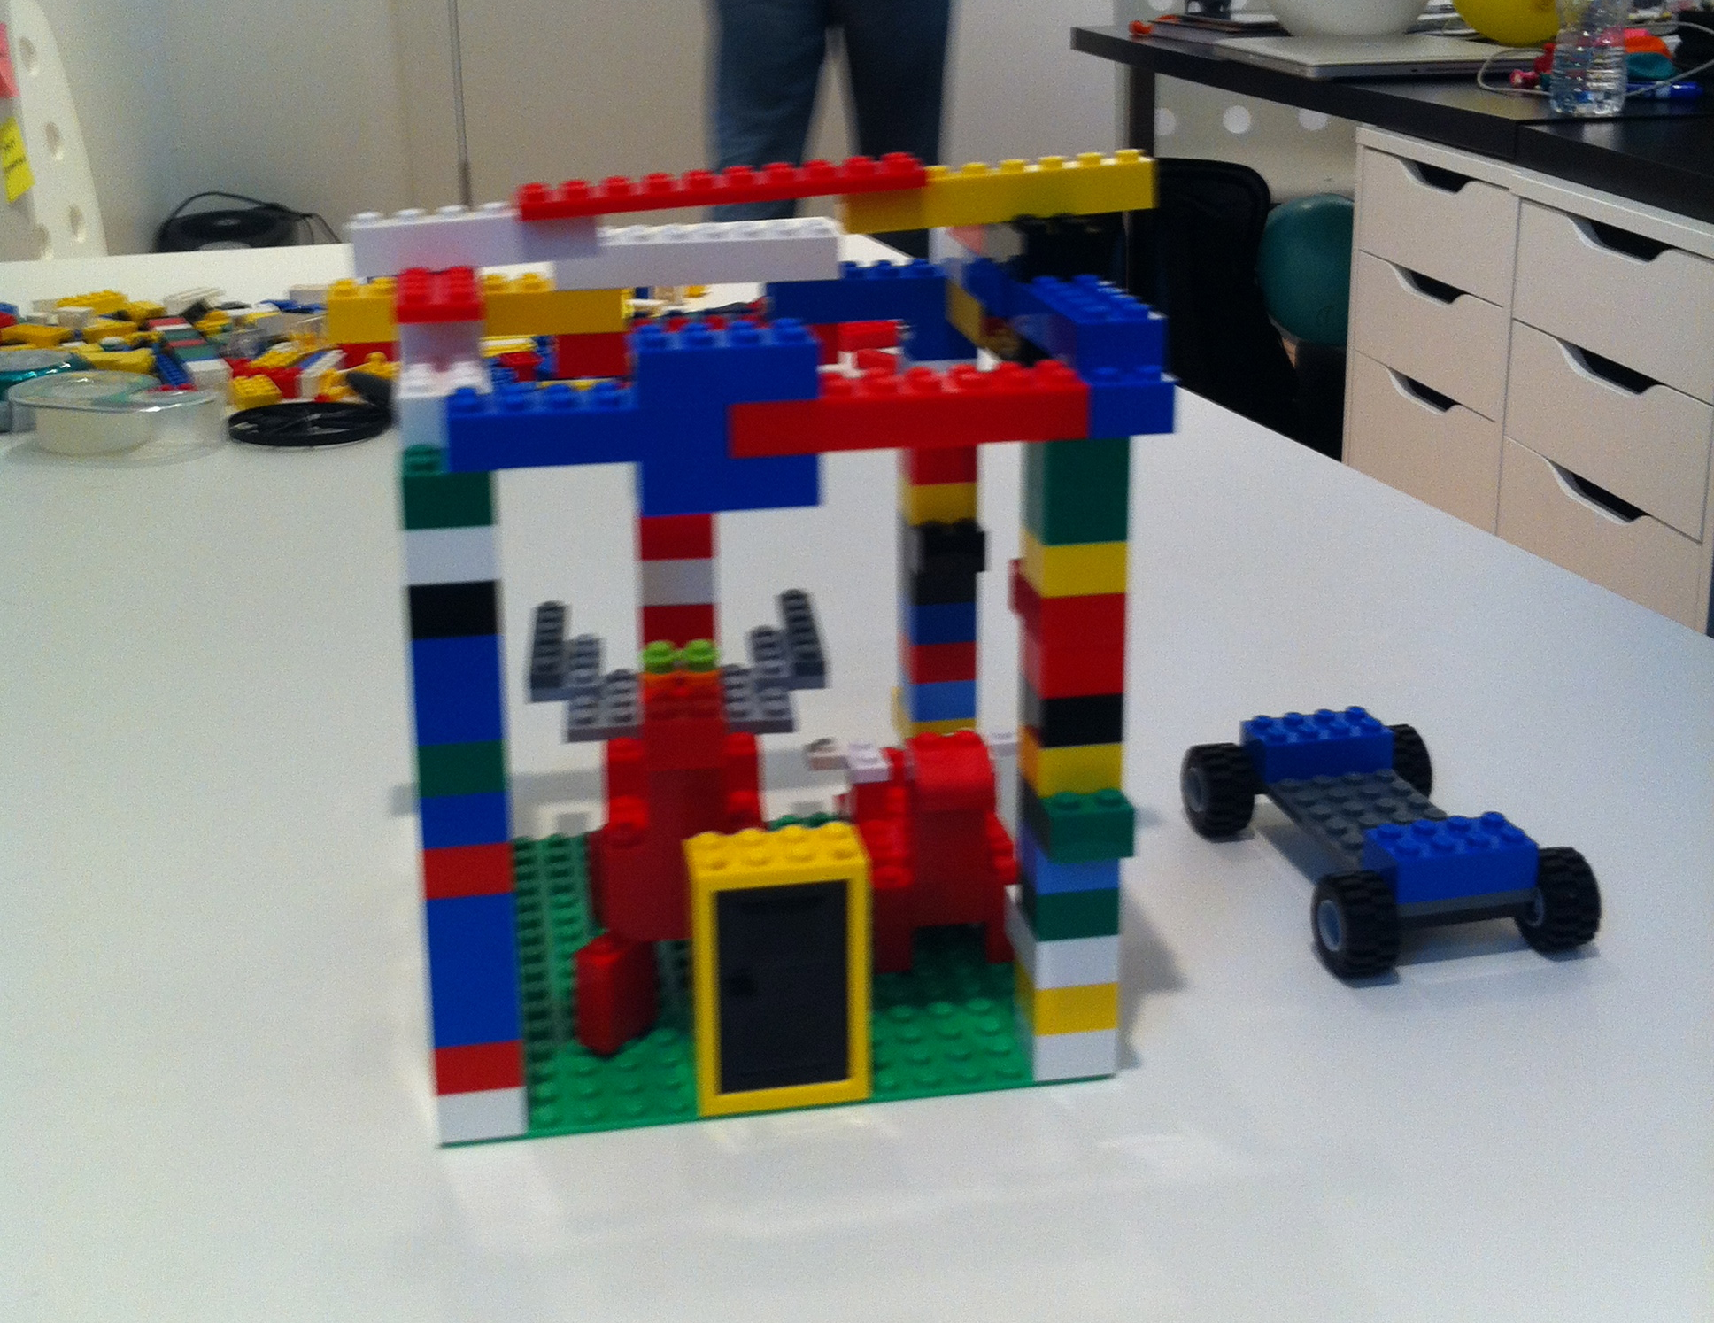
Notes:
You are going to plan, design, and build an animal using Lego’s.
To do this, you are going to understand what to build
Write some user stories
Do some estimation
Plan how you will build
Execute iterations
And finish with a new, never seen before, animal

Slide 9
The workbook
You have a workbook provided (anyone not have one?)
Has sections relating to the agile process
Is not filled with slides, but has relevant information
Please take notes! There are things you need to remember
Notes:
The notebook contains key points of agile, arranged in sections, but not every slide. They will need to take notes themselves

Slide 10

Note taking pages
Notes:
It is important participants take notes – while the workbook provides supporting information to this workshop, it’s up to the participant to record what is important to them, so they can use this information later.
There are several examples of note-taking activity pages in the workbook – explain how each one works briefly, and ask them to choose one (or more) to try. There are also blank pages for note taking.

Slide 11
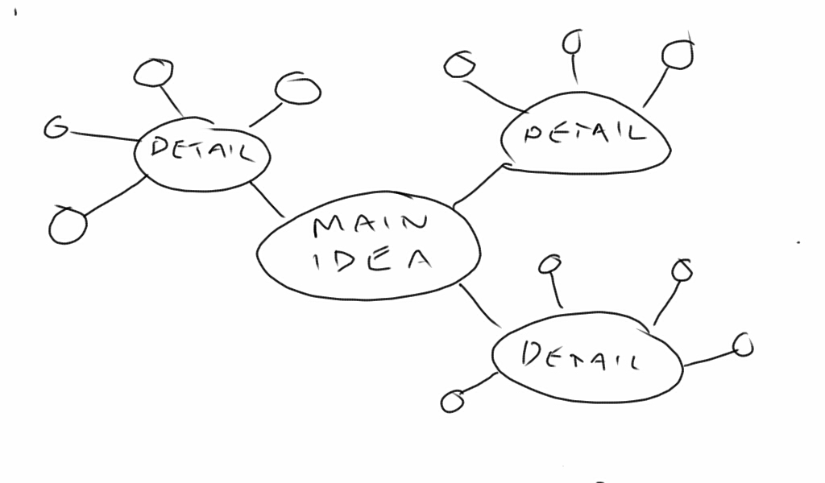
Bubble map
Notes:
Simple bubble diagram. Main idea goes in the large bubble, related ideas in other bubbles, more detail on other bubbles, etc.

Slide 12
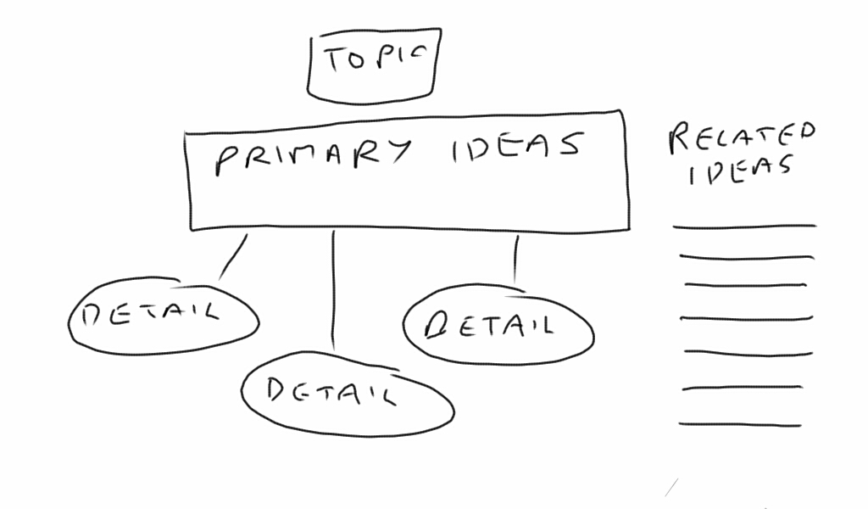
Flowchart
Notes:
Flowchart – structured
Write the topic at the top of the page.
Write each main idea under the title.
Add details in bubbles related to each main idea.
If this relates to other topics, list these at the side

Slide 13
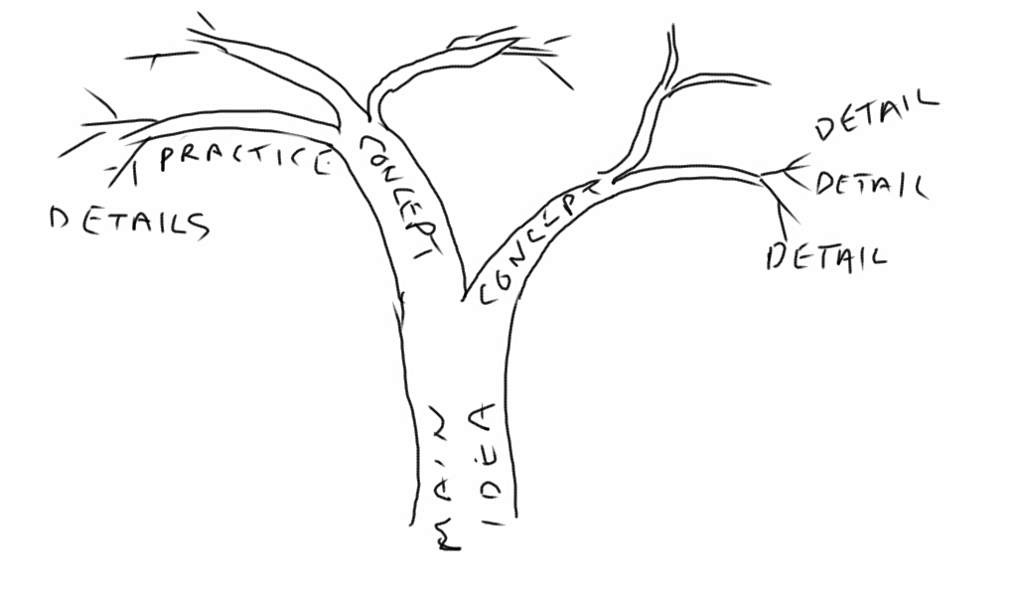
Tree and branches
Notes:
Tree diagram.
The trunk is the main idea you are learning about,
Each branch is a concept or idea related to the main topic
Each smaller branch might be a practice or idea.
You can even draw leaves for more details

Slide 14
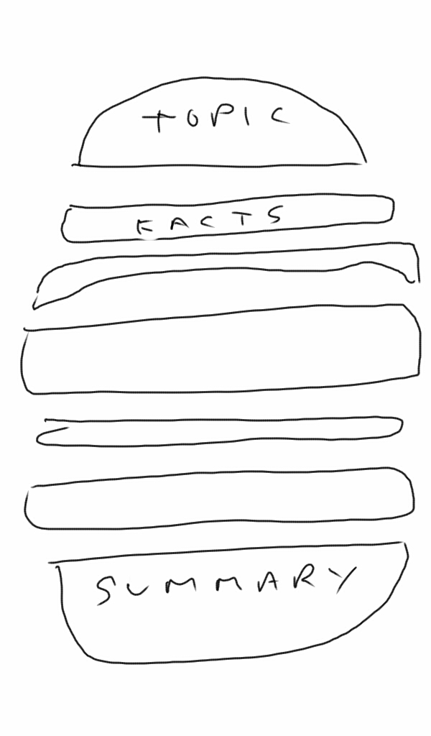
Burger
Notes:
The burger diagram.
Top bun is the main idea you are learning about
Top tomato is a fact that supports the main idea
So is the cheese, the burger, the tomato, next slice of cheese. Put as many ingredients in your burger as you hear ideas.
The bottom bun is a summary of this topic.

Slide 15
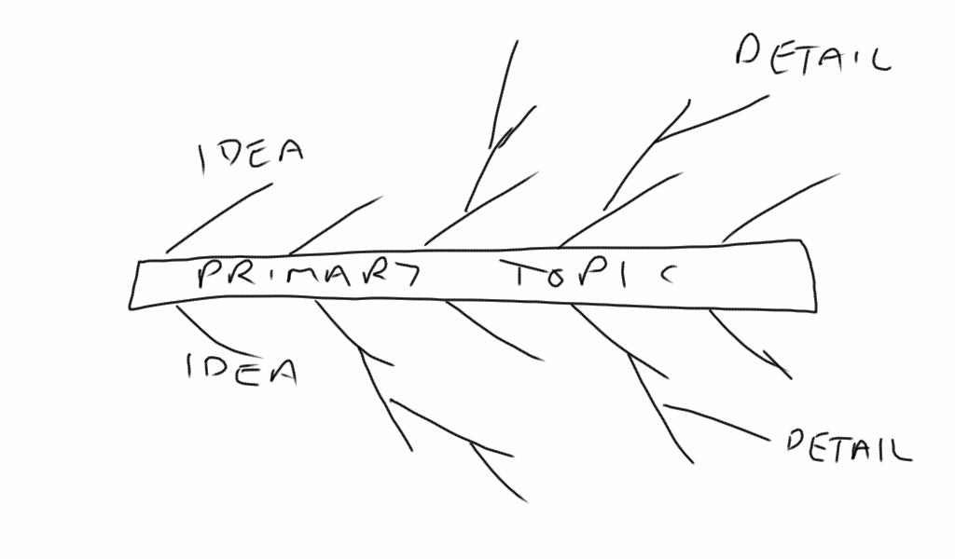
Fishbone
Notes:
Fishbone
Primary topic or idea is the main spine
Each “bone” is an idea or concept relating to the primary topic
Each smaller bone is a detail supporting the idea or concept it is related to

Slide 16
Questions?
Notes:
Thank you for joining us for The Origins of Agile Software Development, a module in Agile Fundamentals. The next module in the series is The Origins of Agile, in which we’ll look at the evolution of agile methodologies.

